Slide 1
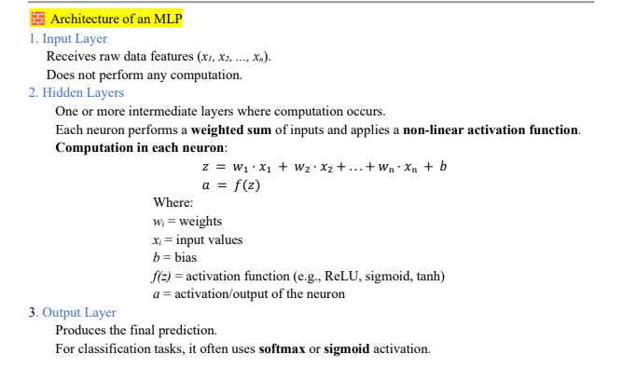

Slide 2
Activation Functions
Activation function decide whether a neuron should be activated or not.
It helps the network to use the useful information and suppress the irrelevant information.
Usually a nonlinear function.
What if we choose a linear?
Linear classifier
Limited capacity to solve complex problems.

Slide 3
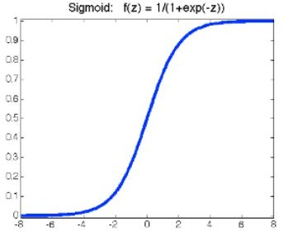


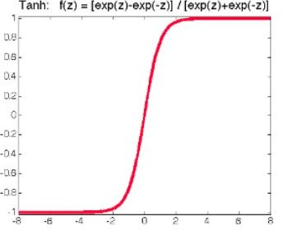
Activation Functions (cont’d)
Sigmoid
continuously differentiable
ranges from 0-1
not symmetric around the origin
Tanh
○
○
scaled version of the sigmoid
symmetric around the origin
vanishing gradient

Slide 4
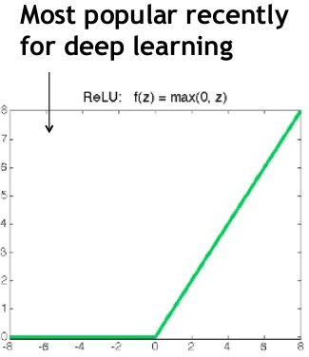

Activation Functions (cont’d)
ReLU
Also called piecewise linear function because rectified function is linear for half of the input domain and nonlinear for the other half.
trivial to implement
sparse representation
avoid the problem of vanishing gradients
dead neurons

